Slide 1






DAB 303 – MARKETING ANALYTICS
GROUP NO. 10
Project 4
CUSTOMER LIFECYCLE VALUE

Slide 2


TABLE OF CONTENTS
1.
INTRODUCTION AND PURPOSE
2.
DATA AND MISSION
3.
EXPLORATORY DATA ANALYSIS
4.
CUSTOMER LIFETIME VALUE MODELING
5. CONCLUSION

Slide 3



INTRODUCTION AND PURPOSE
This document outlines the analysis conducted in Project 4: Customer Lifecycle Value (CLV) for the DAB303 Marketing Analytics course.Through Python tools and techniques, we explore a retailer dataset, focusing on data preprocessing, exploratory analysis, and predictive modeling to understand customer behavior and quantify CLV.
The project aims to extract meaningful insights from the dataset by creating relevant features, conducting exploratory and advanced analyses, and building regression models to predict CLV. The document serves as a guide, detailing methodology, code implementation, and key findings for both technical and business understanding.
LET' S DO IT!

Slide 4



DATA AND MISSION
Our dataset encompasses crucial customer variables, enabling a deep dive into engagement patterns. The mission is clear: unravel Customer Lifecycle Value (CLV) dynamics. Each data point, from purchase history to feedback scores, contributes to a strategic understanding of customer behavior. Our mission is to leverage this data for actionable insights, guiding decisions to enhance customer satisfaction, optimize marketing, and cultivate lasting customer relationships.
LET' S DO IT!

Slide 5

CUSTOMER LIFETIME VALUE: WHERE LOYALTY MEETS PROFITABILITY, CREATING A SUSTAINABLE BOND BETWEEN CUSTOMERS AND SUCCESS.

Slide 6
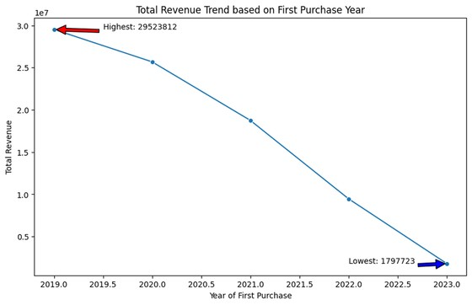
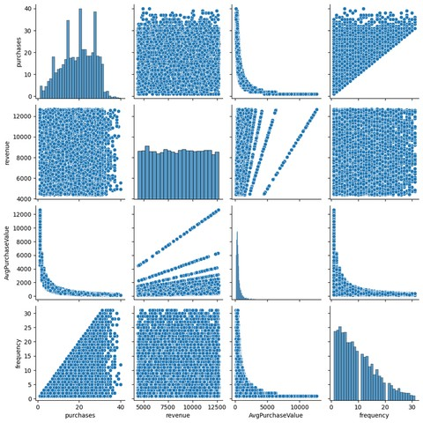
EDA 1
Based on the visual and numerical output, you can observe the fluctuations in total revenue over the years.
The organization experienced a peak in total revenue in 2019, indicating a period of exceptional performance.
The subsequent years, particularly 2023, show a significant decline in total revenue.
EDA 2
Purchases and Revenue: The scatter plot for these two features seems to show a positive correlation, with a general trend of increasing revenue with increasing purchases.
Revenue and Frequency: The scatter plot for these two features seems to show a positive correlation, with a general trend of increasing revenue with increasing frequency.
Average Purchase Value and Revenue seems to show a positive correlation, with a general trend of increasing revenue with increasing average purchase value. This means that customers who spend more per transaction tend to generate more revenue for the company. However, it’s important to note that there are some outliers in the data, which might be skewing the correlation.

Slide 7
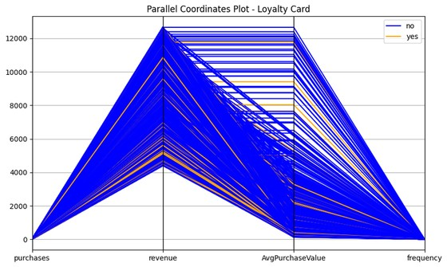
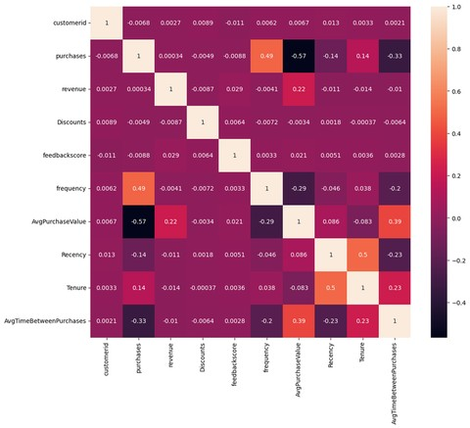
EDA 3
Purchases and Revenue: The lines for these two features seem to be closely following each other, suggesting a positive correlation. This means customers who make more purchases also tend to generate more revenue.
Also we can say from the graph is people have less tendency to have the loyalty card after purchase to so they need to give some service or improve the marketing to have the loyalty card.
EDA 4
Purchases and AvgPurchaseValue: The correlation between these two features is negative and moderate, with a correlation coefficient of -0.57. This means that customers who spend less per transaction tend to make more purchases, and vice versa.
Frequency and Purchases: The correlation between these two features is positive and moderate, with a correlation coefficient of 0.49. This means that customers who visit the store more frequently tend to make more purchases.
AvgPurchaseValue and AvgTimeBetweenPurchases: The correlation between these two features is positive and weak, with a correlation coefficient of 0.39. This means that there is a slight tendency for customers who spend more per transaction to have a shorter time between purchases.
Recency and Tenure: The correlation between these two features is positive and moderate, with a correlation coefficient of 0.5. This means that customers who have been with the company for a longer time tend to have made more recent purchases

Slide 8
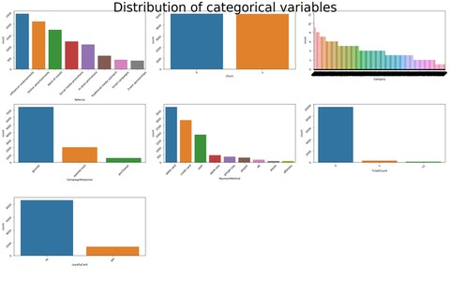
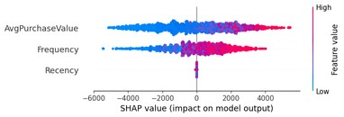
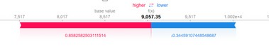
EDA 5
Campaning response:
From the chart we can say that the most of the people have tendency to ignore the campaning. only 5% peple choose to buy the product by viewing the campaning.
Payment Method:
People are buying the product the most of the product using debit card. So we can say that that they have implemented good security.
EDA 6
Based on the plot, we can observe that Frequency has the highest feature importance, followed by Recency and AvgPurchaseValue. This means that Frequency is the most important feature in predicting the target variable, followed by Recency and AvgPurchaseValue.

Slide 9

CONCLUSION
Key Features: Importance Order: Frequency > Recency > AvgPurchaseValue.
Campaign Response: Low Impact: Only 5% conversion from campaigns.
Payment Method: Prevalent Use: Majority use debit cards, indicating trust in security.
Correlation Analysis: Insights: Purchases & AvgPurchaseValue: Negative (-0.57).
Frequency & Purchases: Positive (0.49).AvgPurchaseValue & AvgTimeBetweenPurchases: Weak positive (0.39).
Recency & Tenure: Positive (0.5).Purchases & Revenue: Positive. Loyalty Card Adoption:
Post-Purchase Lag: Limited adoption post-purchase, suggesting room for improvement.
Revenue Trends:2019 Peak: Exceptional performance. 2023 Decline: Substantial drop, requires investigation.
Regression Model: Suitability: Chosen due to lower Mean Squared Error (MSE).
Revenue Correlations: Positive Trends: Revenue correlates positively with Purchases, Frequency, and AvgPurchaseValue.
Outliers: Caution Needed: Address potential influence of outliers on correlations.
Conclusion: Focus Areas: Improve campaign effectiveness, understand post- 2019 revenue decline, boost loyalty card adoption, and monitor outliers for data reliability.

Slide 10



THANK YOU
FOR READING!

